Slide 1
How shall we propagate and disseminate?
Adéla Misarová

Slide 2
What dissemination actually is and why is it important?
To distribute or broadcast information
Can take up half of the total cost of an imformation project
Must be planned from the start

Slide 3
Effective dissemination
To match the means to the message and needs of the audience (method has to work for the target-audience-and for delivered content)
Evidence, that people take more notice of information given by a person

Slide 4
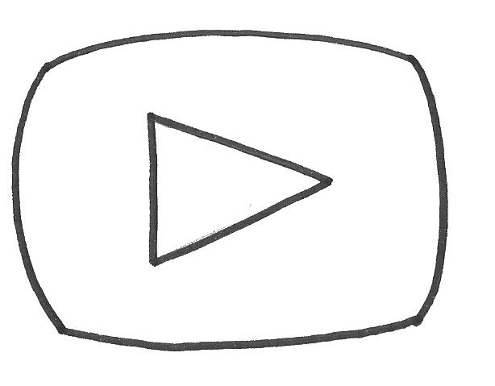
Internet nowdays more used than paper (still some groups, we can‘t touch with internet)
Youtube videos are very effective

Slide 5
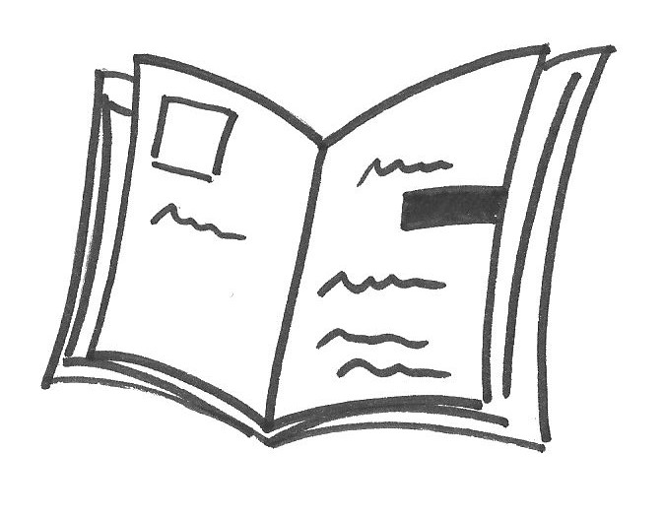
Ways how to propagate:
Newspapers, magazines
Journals (school magazines,
city journals etc.)
Website of our project, school websites

Slide 6
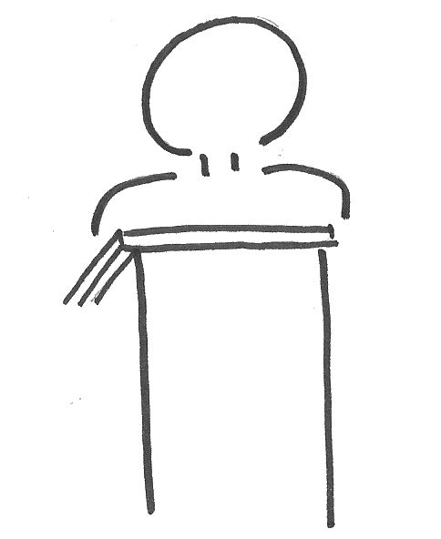
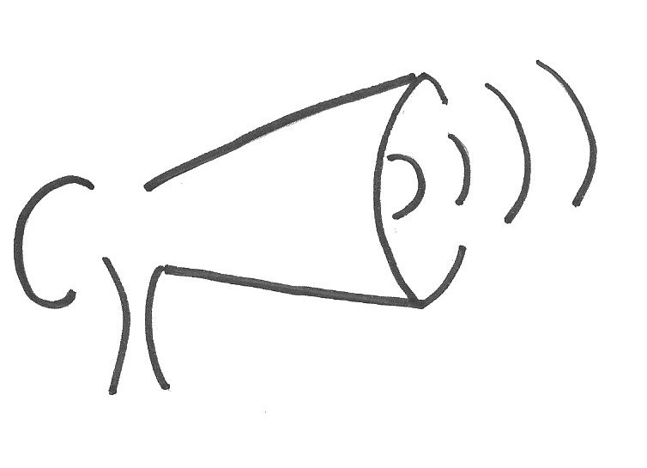
Social networks
Lectures
To talk with students, teachers and inform them (school broadcasting, school campaigns etc.)

Slide 7
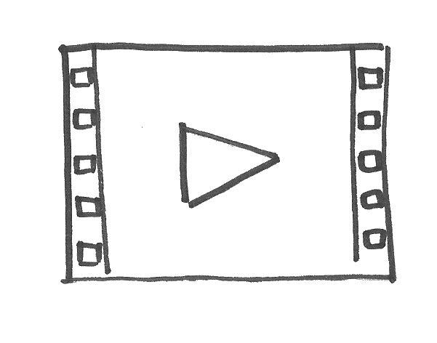
Public school campaigns
Videos

Slide 8
The press What to do for it?
To find newspapers, magazines which contains paragraphs from amateurs
To contact them (our „Metro“)

Slide 9
The press (newspapers, magazines..)
PLUSES | MINUSES
Can deliver a lot of informations | Reading of press dicreases
Can affect random people | Usually need of contacting somebody
Does not discriminate | (does not apply on school magazines)
 | Has to be written effectively

Slide 10
Websites
Has to be kept active
Has to be well-aranged
PLUSES | MINUSES
Easy access | Need to disseminate websites (to please other websites with same topic)
Has no limits in dissemination between more states | Has to be written effectively
 | Language barrier (laziness to read articles in foreign language)

Slide 11
Social networks
To set up a site (facebook)
PLUSES | MINUSES
Affects most teenagers | Leaves out mature people
We can do adverts (easy propagation) | Possibility of misusage (hard to secure)
Easy to use and manage

Slide 12
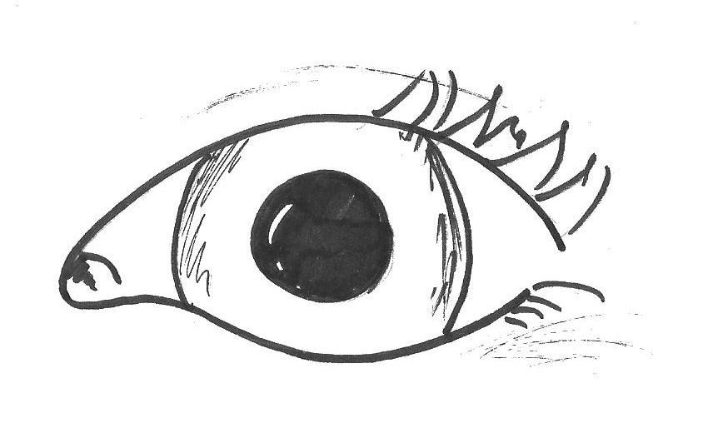
School private campaigns
PLUSES | MINUSES
The most effective way how to grip people | Affects just student in particular schools
Informations are delivered eye to eye | Demanding to prepare

Slide 13
School campaigns for public
PLUSES | MINUSES
The most effective way how to grip people | Demanding to prepare
Informations are delivered eye to eye | Demanding to find some people to visit
 | Demanding to propagate

Slide 14
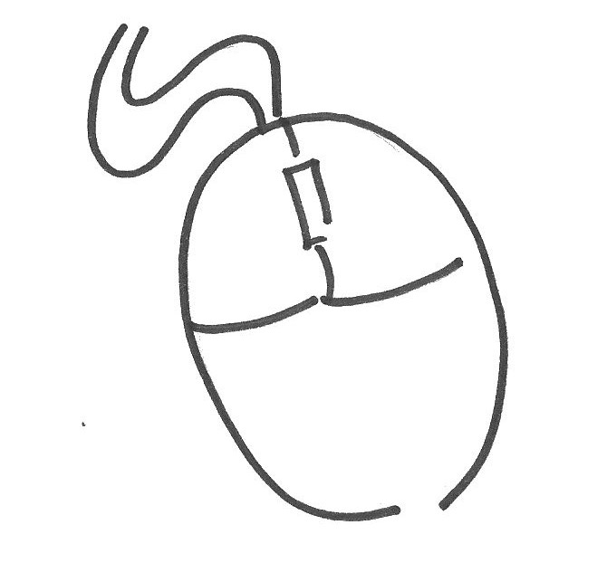
Video (Youtube)
PLUSES | MINUSES
Makes people more interested | Has to be done properly
Tells people‘s stories | Need of good devices
Easy to share (facebook site, website)

Slide 15
The summary
The most effective:
Youtube videos, Social networks, Websites
The least demanding:
Website, Facebook page, School magazines

